Slide 1
Managing Information Technology Resources ITWS 4310
Risk Management
September 24, 2018

Slide 2
Managing IT Resources Class Outline: Mon, Sept 24, 2018
Gamma Nu Eta Company Expose – Outstanding – Thanks
MITR Term Project
Schedule Meetings with Client and Invite Faculty to Meetings - This Week If Not Already Done
Work on “System Requirements” with Client due as part of “Initial Sections” on Oct 10 by 9 PM
Submit Team Project Plan in Gantter plus Narrative tomorrow, Sept 25, by 9 PM
Current Event Articles
Risk Management

Slide 3
Managing IT Resources: ITWS 4310 Term Project Report Outline
Section 1: Executive Summary
Section 2: Introduction
Section 3: Client Organization and Description
Section 4: Project Team
Section 5: Problem Statement
Section 6: IS/IT Solution
Section 7: Methodology
Section 8: IS/IT Requirements
Section 9: IS/IT Design
Section 10: Cost-Benefit Analysis
Section 11: Project Plan/Schedule/Resources
Section 12: Post-Turnover Plan
Section 13: Results and Client Feedback
Section 14: Conclusions
Project Proposal:
Requirements
Part of Initial Sections:
due Oct 9 by 9 PM
Cost-Benefit Analysis
Project Plan
due Sept 25 by 9 PM

Slide 4
Technology Current Events: “Everyone should be terrified of Amazon's Alexa microwave”, Wired UK, Sept 22, 2018. https://www.wired.co.uk/article/amazon-microwave-alexa
Amazon’s hardware division has been busy. This week it has announced a slew of new Alexa-powered devices, including an in-car dashboard assistant and a microwave. Yes, a microwave.
But before you think that Amazon has completely lost its AI mind, it’s clear that the trillion-dollar company is betting huge on Alexa and voice-controlled devices.
Alexa is one of the leading digital assistants on the market, fighting it out with Google Assistant for the top spot, with Siri trailing in third. The growth of the smart speaker market from the launch of the first Echo in November 2014 has been swift, and is expected to be worth up to $30 billion by 2024, according to Global Market Insights. Amazon currently has a smart speaker market share of 67 per cent in Europe.
CEO Jeff Bezos is less secretive about his ambitions for Alexa, however. “We want customers to be able to use Alexa wherever they are,” Bezos said back in July. “There are now tens of thousands of developers across more than 150 countries building new devices using the Alexa Voice Service, and the number of Alexa-enabled devices has more than tripled in the past year.” Bezos wants Alexa in every part of your life – and he usually gets what he wants.

Slide 5
Technology Current Events: “Google CEO Sundar Pichai warns employees: Don't get too political, or else ”, Yahoo Finance, Sept 22, 2018. https://finance.yahoo.com/news/google-ceo-sundar-pichai-warns-151300302.html
In a memo to employees, Google CEO Sundar Pichai warned that there will be consequences if they let politics get in the way of the work.
Google is under increasing political pressure from President Donald Trump and his allies, which has accused the search giant of being biased against conservatives.
The White House is considering an antitrust investigation of Google and Facebook over "online platform bias," it was reported on Saturday.
"We do not bias our products to favor any political agenda," Pichai reportedly wrote. "The trust our users place in us is our greatest asset and we must always protect it. If any Googler ever undermines that trust, we will hold them accountable."
Pichai's memo comes as the search giant finds itself in the crosshairs of President Donald Trump and his allies amid accusations of political bias. Trump said in August that Google is "taking advantage of a lot of people" and accused the company of rigging search results against him.
Most recently, a Wall Street Journal story revealed that in early 2017, some Google employees were internally discussing ways to manipulate search results in protest of Trump's travel ban. In his memo to Googlers, Pichai called allegations that the company would seriously consider that kind of action "absolutely false."
However, political pressure on Google is mounting. The White House is considering an antitrust investigation into "online platform bias" at Google and Facebook, it was reported on Saturday.

Slide 6
Managing Project Risk

Slide 7
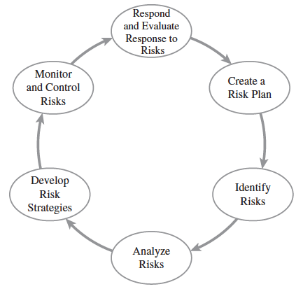
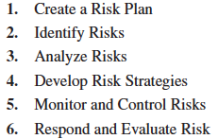
Project Risk Management Processes

Slide 8
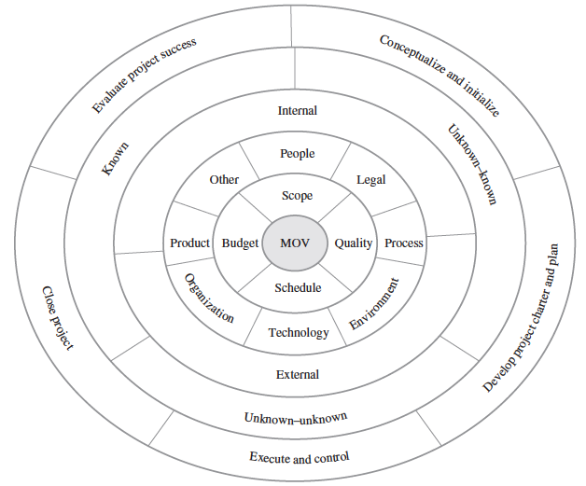
STEP 2 – Identify Risks through a Project Risk Identification Framework
Risk Identification
Framework

Slide 9
STEP 3 – Analyze Risks
Risk = f(Probability * Impact)
Risk assessment focuses on prioritizing risks so that
an effective strategy can be formulated for those risks
that require a response.
Depends on Stakeholder risk tolerances
Can’t respond
to all risks

Slide 10
STEP 3 – Analyze Risks: Payoff Table
Schedule Risk | Probability | Payoff In Thousands | Prob * Payoff In Thousands
Proj Comp 20 days early | 5% | $200 | $10
Proj Comp 10 days early | 20% | $150 | $30
Proj Comp on schedule | 50% | $100 | $50
Proj Comp 10 days late | 20% | $0 | $0
Proj Comp 20 days late | 5% | $(40) | $(2)
Expected Value |  |  | $88

Slide 11
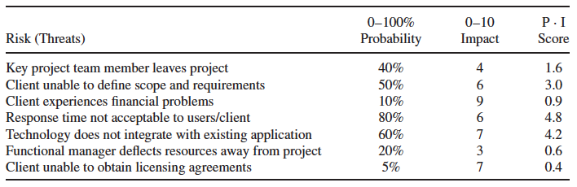
STEP 3 – Analyze Risks – Risk Impact Table
IT Project Risk Impact Analysis

Slide 12
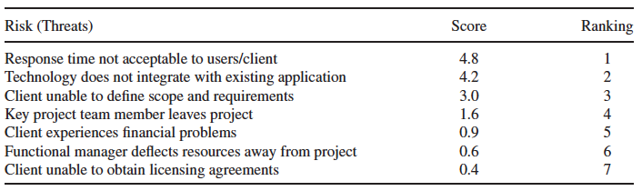
Risk Rankings

Slide 13
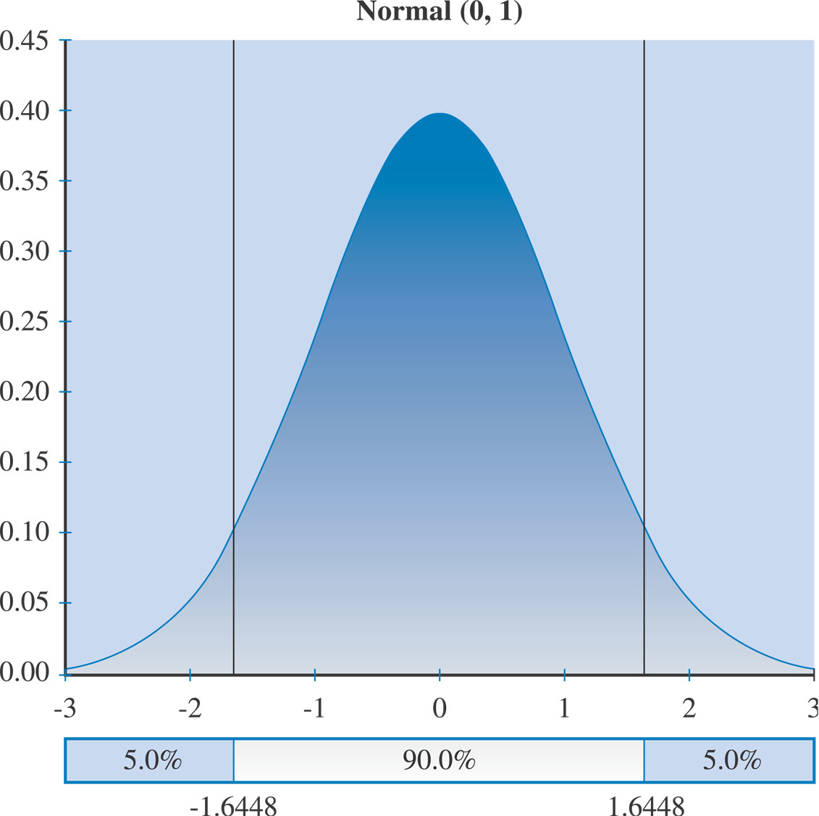
Normal Distribution

Slide 14
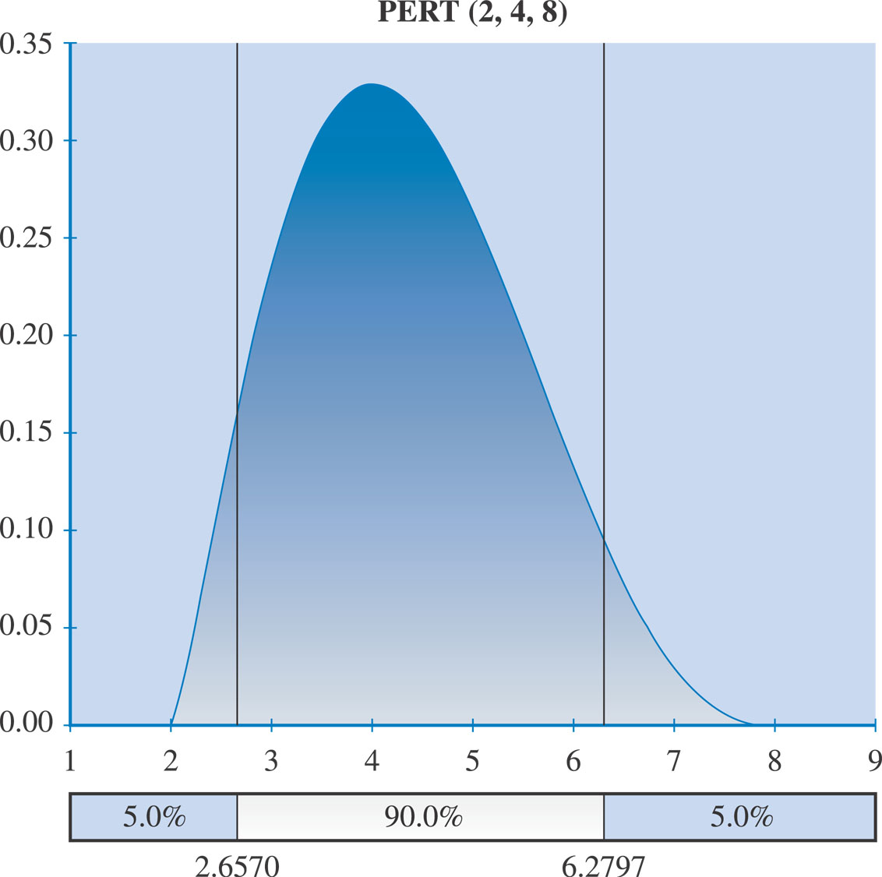
PERT Distribution

Slide 15
Simulations
Monte Carlo
Technique that randomly generates specific values for a variable with a specific probability distribution
Goes through a number of trials or iterations and records the outcome

Slide 16
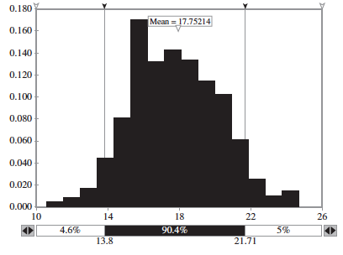
Monte Carlo Simulation

Slide 17
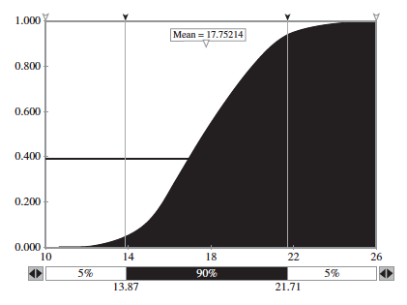
Cumulative Probability Distribution

Slide 18
STEP 5 – Monitor and Control Risk
Risk Audits
External to project team
Risk Reviews
Internal
Risk Status Meetings & Reports

Slide 19
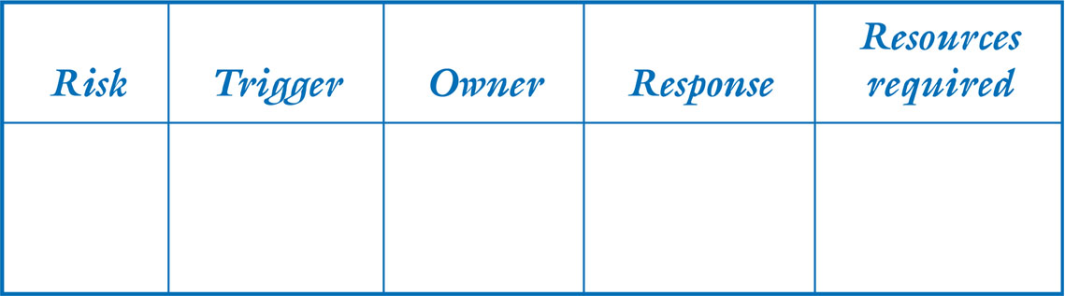
STEP 5 – Respond and Evaluate Response to Risk through a Risk Response Plan that includes:
A trigger which flags that the risk has occurred
An owner of the risk (i.e., the person or group responsible for monitoring the risk and ensuring that the appropriate risk response is carried out)
A response based on one of the four basic risk strategies
Adequate resources

Slide 20
STEP 5 – Respond and Evaluate Response to Risk through Risk Evaluation
Lessons learned and best practices help us to:
Increase our understanding of IT project risk in general.
Understand what information was available to managing risks and for making risk-related decisions.
Understand how and why a particular decision was made.
Understand the implications not only of the risks, but also the decisions that were made.
Learn from our experience so that others may not have to repeat our mistakes.

Slide 21
An Overview of Risk and Risk Management
Introduction
Importance of risk and risk management as a discipline was highlighted from 2007 to 2009, during the global financial sector crisis. Well-known financial firms, which were purported to manage “conservatively” and to have “strong risk management” processes discovered that their employees had bet heavily on subprime mortgages and financial derivatives. The value of those instruments was written down drastically, and the firms were suddenly insolvent.
Firms in other industries also had their fair share of high-profile risk issues: BP and its Deepwater Horizon disaster in the Gulf of Mexico, Toyota Motor Company had a worldwide recall of millions of its cars.

Slide 22
An Overview of Risk and Risk Management
Types of Risk
Risk in Project Management
Operational Risk
Equity risk premium
Volatility and risk

Slide 23
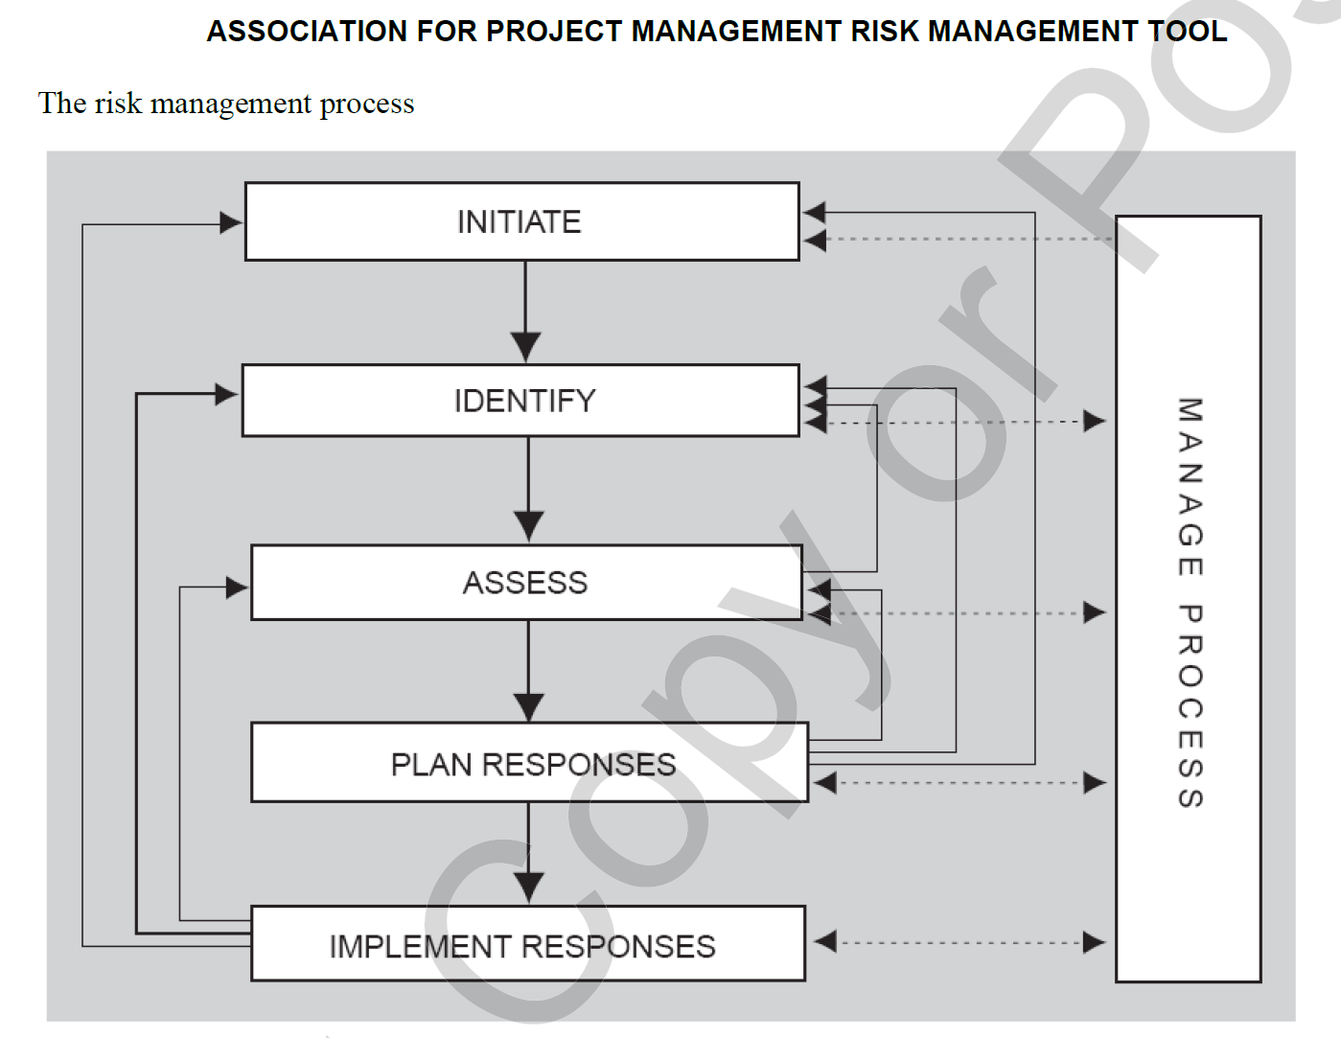
An Overview of Risk and Risk Management

Slide 24
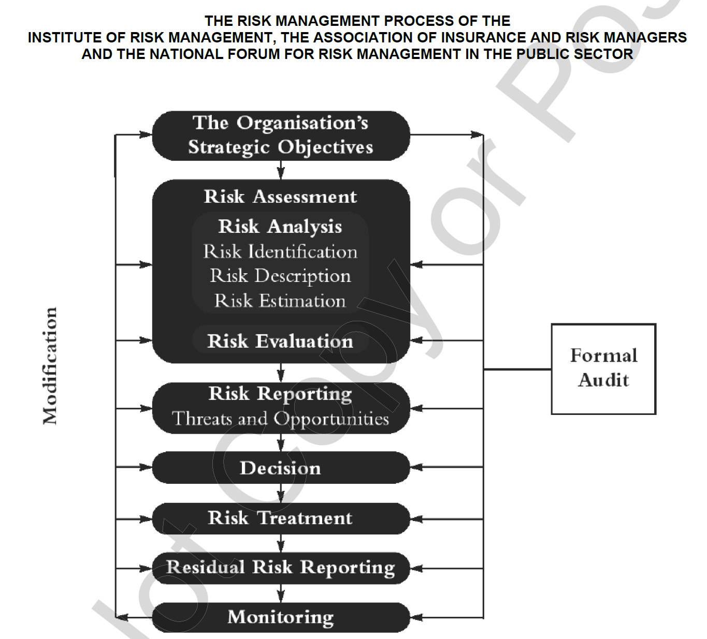
An Overview of Risk and Risk Management

Slide 25
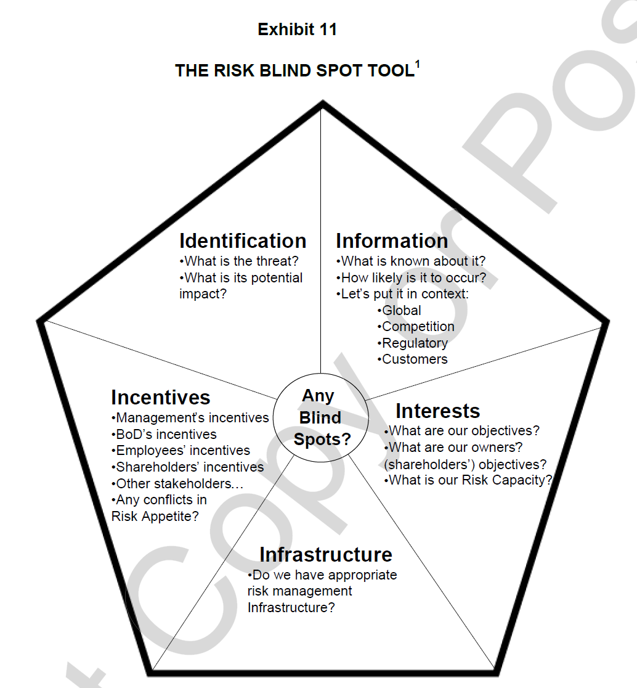
An Overview of Risk and Risk Management

Slide 26
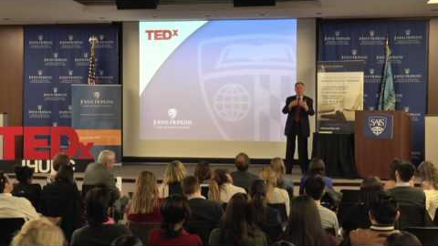
Enterprise Risk Management
Notes:
https://www.youtube.com/watch?v=voGyHN-tWMg

Slide 27
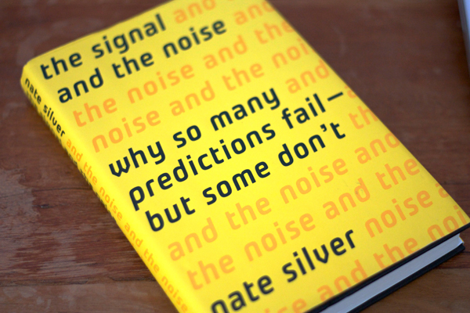
The Signal and the Noise by Nate Silver
Thoughts?
Why bring up this video/book?

Slide 28
The Signal and the Noise by Nate Silver
This book is about information, technology, and scientific progress.
This is a book about the things that make us smarter than any computer, and a book about human error.
This is a book about how we learn, one step at a time, to come to knowledge of the objective world, and why we sometimes take a step back.
This is a book about prediction, which sits at the intersection of all of these things

Slide 29
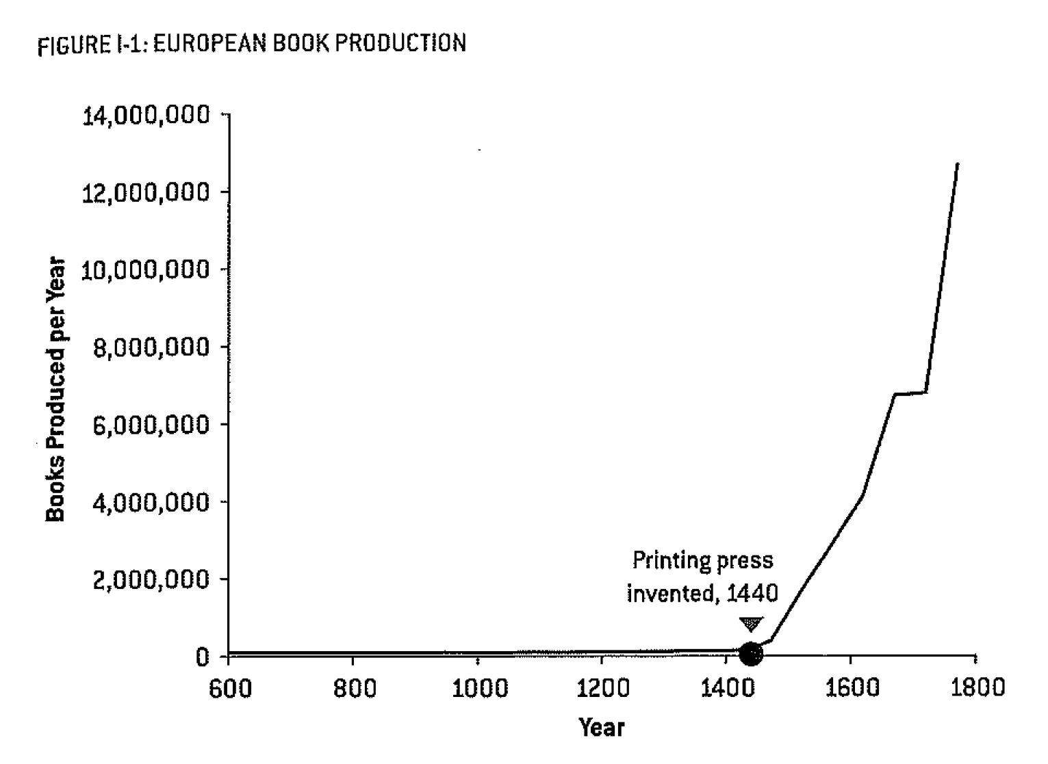
The Signal and the Noise by Nate Silver
More Information, More Problems
Printing Press
Hundreds of Years of Holy Wars
Reduction in the Cost of a Book from about $20,000 in today’s dollars to about $70
The amount of information was increasing much more rapidly than our understanding of what to do with it or our ability to differentiate the useful information from the mistruths

Slide 30
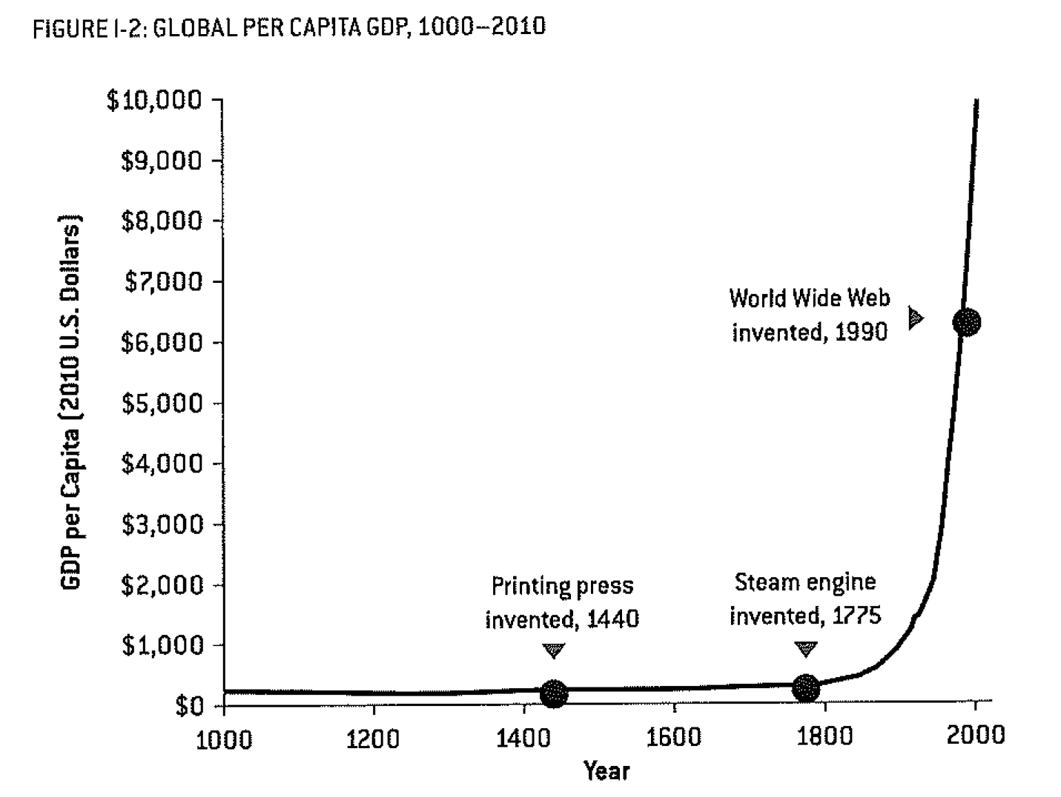
The Signal and the Noise by Nate Silver
Industrial Revolution
The importance of the Industrial Revolution is hard to over-state. Throughout essentially all of human history, economic growth had proceeded at perhaps 0.1% per year, enough to allow for a very gradual increase in population, but not any growth in living standards.
Growth in productivity and living standards of about 2% per year since the beginning of the industrial revolution.

Slide 31
The Signal and the Noise by Nate Silver
The Productivity Paradox
The Promise and Pitfalls of Big Data
Why the Future Shocks Us
The Prediction Solution
“The Signal is the Truth”
“The Noise is what distracts us from the Truth”

Slide 32
The Signal and the Noise by Nate Silver
Outline of the Book
First three chapters are about the failures in prediction of the recent financial crisis, the successes in baseball, and the realm of political predictions.
Chapters 4 – 7 focus on dynamic systems; the weather, the movement of tectonic plates that cause earthquakes, the behavior of the economy, and infectious diseases.
Chapters 8 – 10 turn toward solutions, using Bayes Theory to improve results for a sports bettor, chess, and poker.
Bayes Theorem is used on more existential issues, global warming, terrorism, and financial markets in Chapters 11 - 13

Slide 33
The Signal and the Noise by Nate Silver
Key Points
Progress has been made in Weather Forecasting – computation and human insight – understand the physical phenomenon
Progress has not been made in Earthquake Predictions – even with computation power and immense scientific research
Little to no progress has been made in economic forecasting beyond 6 months.
Political pundits are no better at predicting events than the flip of a coin.
Over-confidence is a significant problem in predictions.

Slide 34
The Signal and the Noise by Nate Silver
Think Probabilistically
Information becomes knowledge, only when you know the context
Use Bayes Theorem which requires a “prior” belief
Bayes Theorem says that we should update our prediction whenever we get new information
Try and Err and get better and closer to the truth

Slide 35
Managing IT Resources Week 5 Assignments
Submit Team Project Plan in Gantter plus Narrative, Sept 25, by 9 PM
Read “Descriptive Statistics in Microsoft Excel” included in the HBS Press Coursepack for class on Thursday
Be prepared to take a Quiz on the Reading Materials and the Current Events at the beginning of Class on Sept 27 – may also include material from Monday’s class.
Work on Term Project with Client, especially the “Requirements” due as part of the Initial Sections on Oct 9 by 9 PM

